Slide 1

Analysis of porto city areas
A study of area types near metro stations

Slide 2
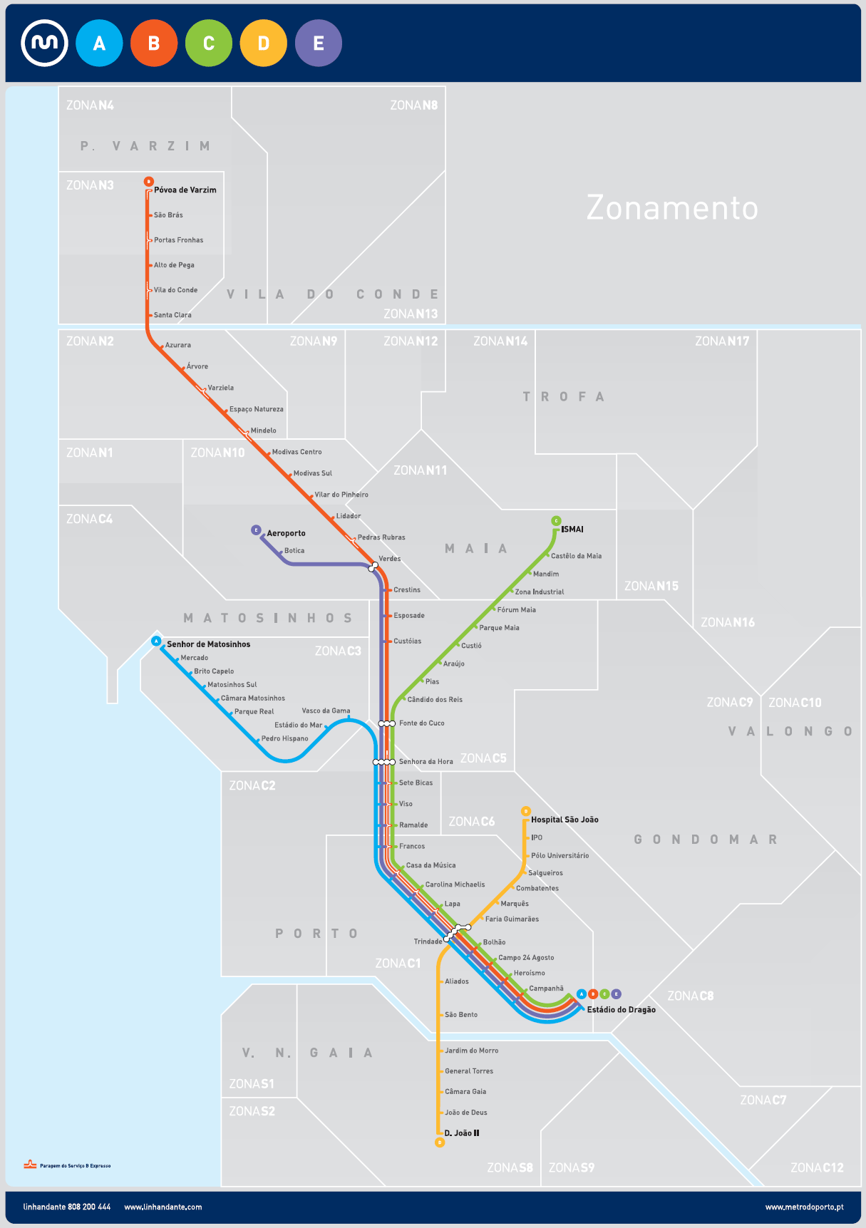
Porto Metro

Slide 3

Business Problem
Porto Metro is one of the largest public transit systems in Portugal, being one of the crucial means of transportation for work and leisure trips in the city.
For this project, we want to look at the neighborhoods surrounding metro stations and classify them.
By analyzing this data we can classify stations by primary usage.
This data is useful for city planners to determine where from and where to people are most likely to travel for work and leisure.
This can help plan further extension of the network and find places for new development.

Slide 4
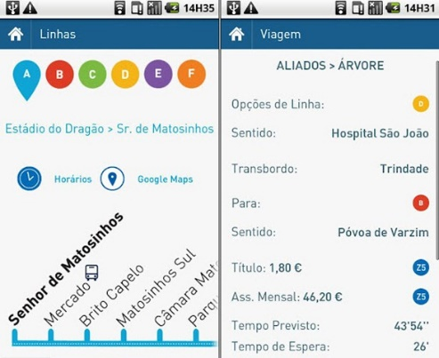
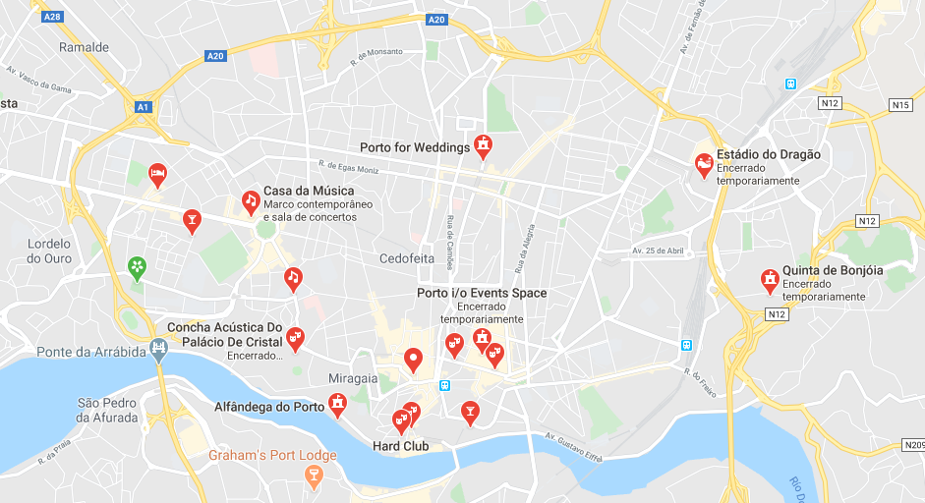
Data
We’ll need data on the location of stations and on the venues closest to them:
1. List of stations and their geographical coordinates using Foursquare API, with category = Metro Station.
2. Foursquare API to explore venue and venue types surrounding each station.
We’ll be querying the number of venues of each type in each category in a radius around each station.

Slide 5

Getting Metro data
Using Foursquare API:
Search Endpoint;
categoryId='4bf58dd8d48988d1fd931735’, corresponding to metro stations
Data Output Format:
{'id': '4bbc46a0e436ef3bc35e5664’,
'name': 'Metro Trindade [A,B,C,D,E,F]’,
'location’:
{'address': 'R. de Camões’,
'crossStreet': 'Lg. Dr. Tito Fontes’,
'lat': 41.15211447651871,
'lng': -8.609718140360703,
'labeledLatLngs': [{'label': 'display', 'lat': 41.15211447651871, 'lng': -8.609718140360703}],
'distance': 298,
'cc': 'PT’,
'city': 'Porto’,
'state': 'Porto’,
'country': 'Portugal’,
'formattedAddress': ['R. de Camões (Lg. Dr. Tito Fontes)', 'Porto', 'Portugal’]},
'categories’:
[{'id': '4bf58dd8d48988d1fd931735’,
'name': 'Metro Station’,
'pluralName': 'Metro Stations’,
'shortName': 'Metro’,
'icon': {'prefix': 'https://ss3.4sqi.net/img/categories_v2/travel/subway_', 'suffix': '.png'}, 'primary': True}],
'referralId': 'v-1593600245’,
'hasPerk': False}

Slide 6
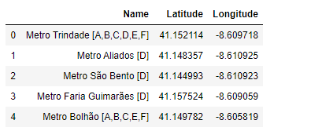
Getting Metro data
After data cleaning, it was possible to extract the data in the following format for further analysis.

Slide 7
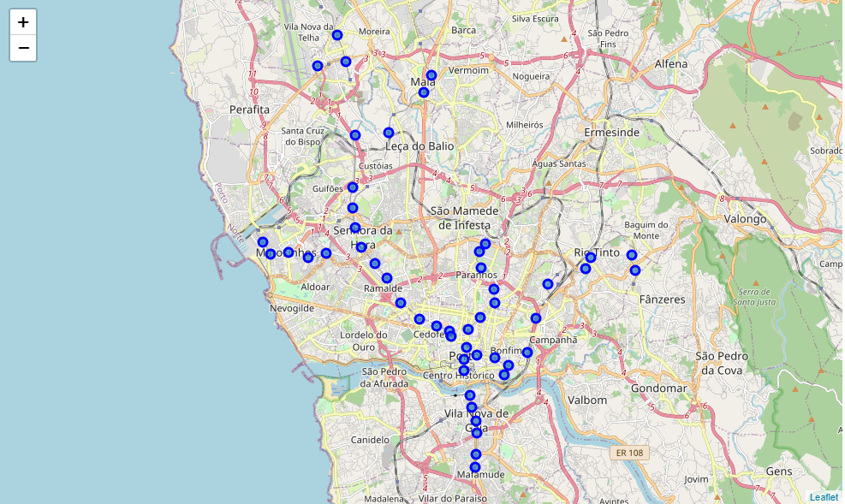
Getting Metro data
Using Folium library:

Slide 8
Getting Venue data
Using Foursquare API:
Get most common categories and associated ID:
For each station, get venues in each category.
Arts & Entertainment (4d4b7104d754a06370d81259)
College & University (4d4b7105d754a06372d81259)
Event (4d4b7105d754a06373d81259)
Food (4d4b7105d754a06374d81259)
Nightlife Spot (4d4b7105d754a06376d81259)
Outdoors & Recreation (4d4b7105d754a06377d81259)
Professional & Other Places (4d4b7105d754a06375d81259)
Residence (4e67e38e036454776db1fb3a)
Shop & Service (4d4b7105d754a06378d81259)
Travel & Transport (4d4b7105d754a06379d81259)

Slide 9
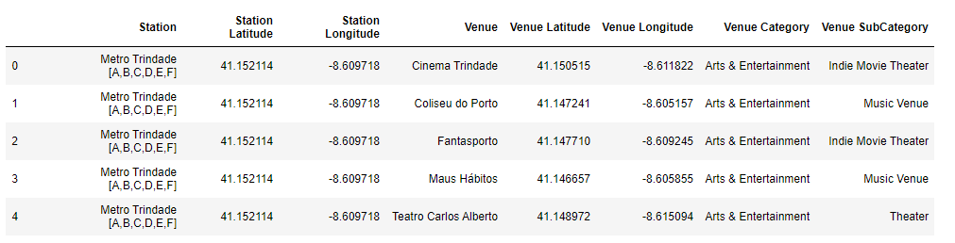
Getting Venue data
Venue and station data:

Slide 10
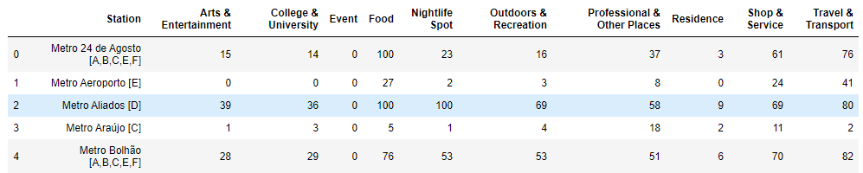
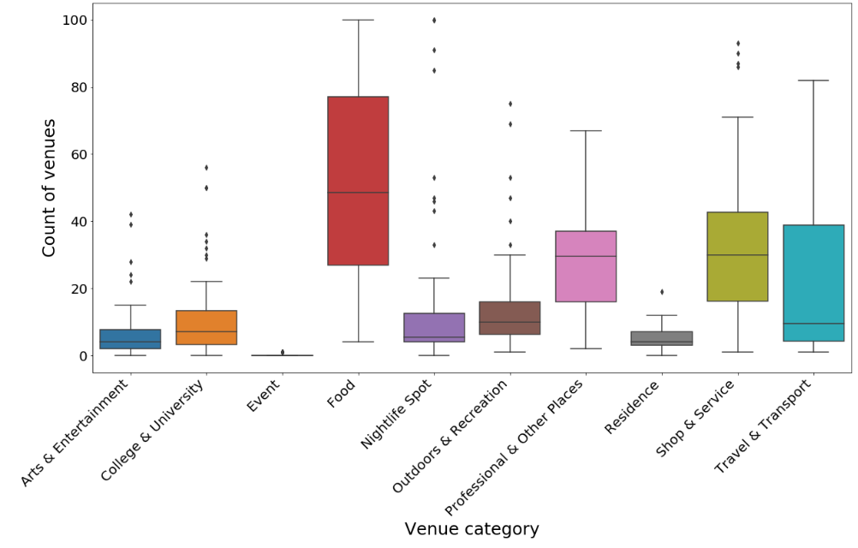
Getting Venue data
Cleaning venue and station data, counting the number of venues in each category:

Slide 11
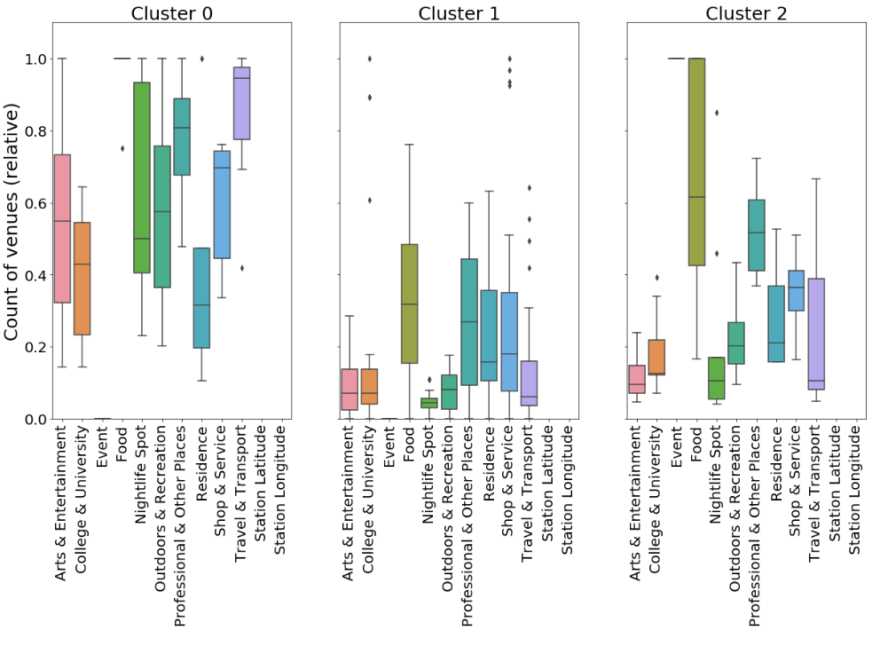
Clustering data
Using k-means clustering with Scikit-learn:

Slide 12
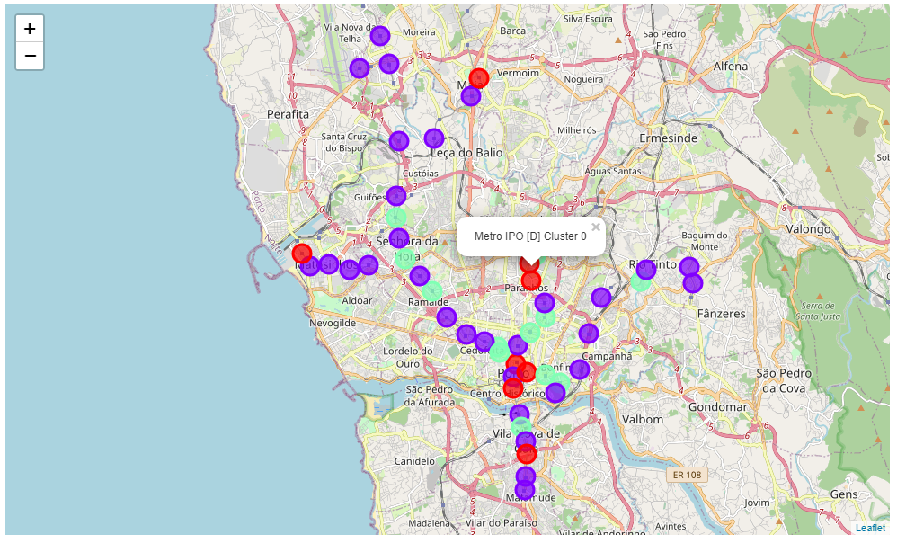
Clustering data
Visualization in the map:

Slide 13
Results
Here is how we can characterize the clusters by looking at venue scores
Cluster 0 (Red) has consistently high scores for all venue categories. This is the most diversely developed part of the city, with lots of restaurants and night life
Cluster 1 (Purple) has balanced marks between residential, professional, food and services, being the most common type of area.
Cluster 2 (Green) is similar to Cluster 1, but with more food places and professional venues.
Plotting the clusters on a map shows us that:
Cluster 0 places are the most high density spots, where people tend to converge for all activities, but, in particular night life;
Cluster 1 is scattered all over the city. As Porto doesn't have very accentuated business or residential areas, we see the mix described by this cluster to be the most common;
Cluster 2 show places more focused on professional and food places all over the city, being areas a bit more specialized on workplaces than cluster 2.

